Slide 1
Welcome to
Notes:
Welcome to Parachute Brain Waves!
Introduce yourself to the participants with your name and role.
Lay the “ground rules” for the group (e.g., raise your hand if you have a question, listen when others are speaking, etc.)

Slide 2
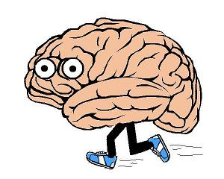
Question
What is the most important part
of your body?
Your Brain!
Notes:
Ask: What is the most important part of your body?
YOUR BRAIN!

Slide 3
We are going to talk about...
    The importance of the brain
    What the brain does
    How the brain works
    Why it is so important to protect the brain
    How to protect the brain
Notes:
What is Parachute Brain Waves? Today we are going to learn about the brain, do some fun activities that will show you how important it is, and learn how to protect ourselves from injuries.

Slide 4
Cells
Q: What is a cell?
A: Building blocks to our bodies
The human brain is made of specialized cells called neurons.
Q: Guess how many neuron cells there are in our brain?
A: 100 billion neurons
Notes:
Q: Does anyone know what a cell is?
A: A cell is the smallest building block in our body – our body is made up of billions of them. Cells are like Lego. Just like you build something with Lego, the cells build the human body.

Slide 5

The Neuron
The brain is like a big message centre!
Messages are sent and received
in the brain all the time
Neurons send and receive messages
telling us how we think, move and feel
Neurons DO NOT grow back if they are injured
Notes:
No other cell in the body has specialized signaling like neurons. Messages can be sent from the body to the brain, and from the brain to the body.
Reinforce: If neurons get damaged, they do not repair themselves. It’s important to protect your neurons!

Slide 6
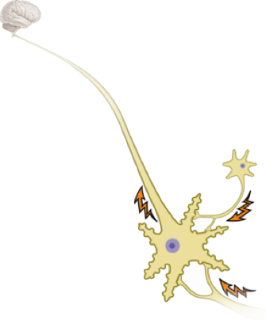
The Neuron
Neurons are different from other cells in our body because they have specialized branches.
    Axon: Sends messages to other neurons
Axon
Notes:
The axon comes out of the soma (the centre of the neuron) to pass signals to other neurons.

Slide 7
The Neuron
Neurons are different from other cells in our body because they have specialized branches.
    Dendrite: Receives messages from other neurons
Dendrites
Notes:
The dendrite is the part of the neuron that receives the message. It is the part of the neuron that looks like a starfish.
Neurons line up like a chain. The brain sends a message to the first neuron, and that message is passed on from one neuron to the next down the chain until it reaches its destination.

Slide 8
Activity Time!
Notes:
8
Activity: Pass the Note Activity! (Instructor Guide p.8)
Divide the class into two uneven rows. The class is now two separate chains. Each person is a neuron, sending signals from the Brain (first person) to the Leg (last person). Hand a piece of paper to each “Brain”. Make they don’t peek at the note!
Say “I have a message on a piece of paper in my hand that the brain is going to pass to the first neuron, and they are going to pass it back to the person behind them and keep going all the way to the end. It is going to be like a race, and once the message reaches the last person, they shout out the message. Ok, I am going to send out the message on the count of 3, and the last person will read it . . . 1, 2, 3!” Then once the last person reads it, you ask the class, “Which line finished first?” Then you ask, “What is different about that line compared to the other?” and the answer is “it’s shorter”.
Explain: The number of neurons in a chain affects the speed a message can be sent. It will take longer for a signal to reach its final destination if there are more neurons. Here’s an example: When you take a drink of hot chocolate, you realize right away that it’s too hot and you stop drinking it. But, when you walk on a beach… It takes a minute to realize how hot the sand is. This is because the message has to travel along a set of neurons all the way from your brain to your feet, whereas with the hot chocolate, the message only has to travel from your brain to your tongue.

Slide 9
Anatomy
Notes:
Q: Now that we know that the brain is made of billions of neurons, what does it do?
A: It controls our ability to think, move, see, hear, taste, and smell. This is why the brain is so important!

Slide 10
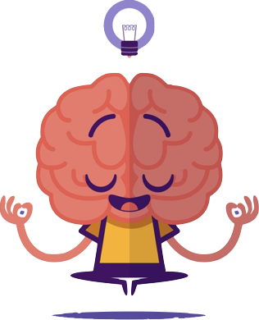
The Brain
Q: Why is the brain so important?
Q: How much do you think your brain weighs?
A: It controls our ability to think, move, see, hear, taste and smell.
A: 2 ½ to 3 lbs (about 1.3 kg)
Notes:
Q: Why is the brain so important?
A: It controls our ability to think, move, see, hear, taste, and smell.
Q: How much do you think our brain weighs?
A: weighs 2 ½ to 3 lbs (about 1.3 kg)

Slide 11
The Lobes of the Brain
The brain has 4 important lobes:
  Frontal Lobe
  Parietal Lobe
  Temporal Lobe
  Occipital Lobe
Notes:
The brain has 4 important lobes: Frontal, Parietal, Temporal, Occipital
Each part of the brain plays an important role in our life.

Slide 12
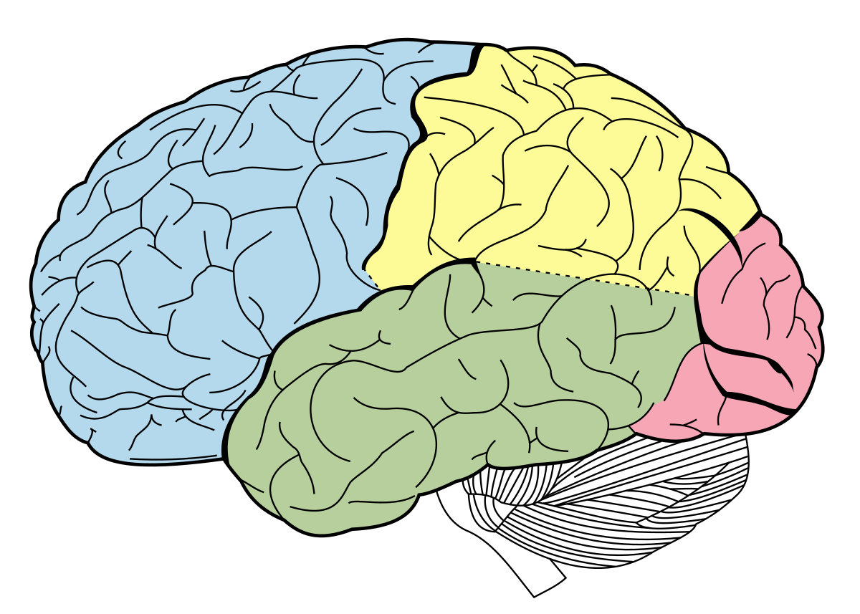
The Lobes
Frontal Lobe
Parietal Lobe
Temporal Lobe
Occipital Lobe
Notes:
As you explain the lobes, have students label them on page 4 of the Activity Booklet.
Show participants where each lobe is on your head.
Frontal Lobe:
Allows you to solve problems, like a math problem
If damaged: unable to figure out your math homework
Parietal Lobe:
Tells you information about what you are tasting and touching, like if you taste something sweet or touch something cold.
If damaged: you wouldn’t realize if something was sweet or bitter
Temporal Lobe:
Allows you to hear and smell
If damaged: you couldn’t hear a horn honking at you when you are on a bike
Occipital Lobe:
Controls your vision
If damaged: You could be blind

Slide 13
The Cerebellum
An important part of the brain, but not one of the lobes.
Cerebellum
Notes:
Cerebellum:
an important part of brain but it is not one of the lobes
Important: coordination so we can play sports and keep balance on our bikes and skateboards.
Demonstrate coordination by putting a pen cap on a pen. You can do this when your cerebellum is healthy.
If damaged: lack coordination. It would be hard to put the pen cap on if your cerebellum was damaged.

Slide 14
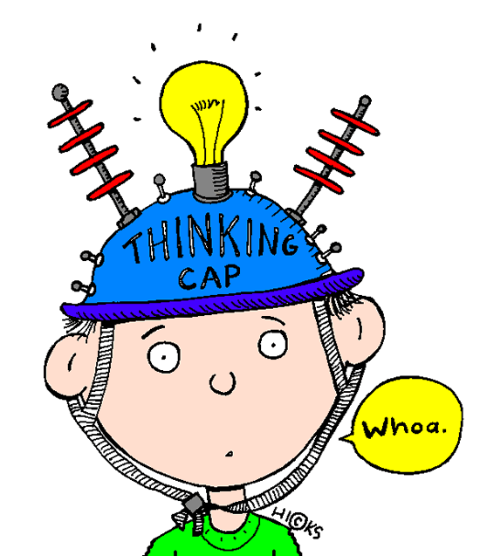
Question
Q: What happens when we damage our lobes?
A: Life would just not be the same!
Notes:
So…Can we live without our lobes? (Yes put up your hand; no put up your hand)
Yes and No… Life with a damaged lobe would just not be the same. If your occipital lobe is damaged, you could be blind even though your eyes are in perfect condition. The brain is where our perception of the world around us comes together.
Let’s look at some examples.

Slide 15
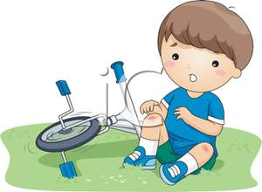
What lobe could be damaged?
Rob fell off his bike and he wasn’t wearing his helmet.
When he came home from the hospital, he didn't like playing video games or soccer any more, and he would laugh at different jokes.
Frontal Lobe
Notes:
A: FRONTAL LOBE
The frontal lobe is responsible for functions like personality.

Slide 16
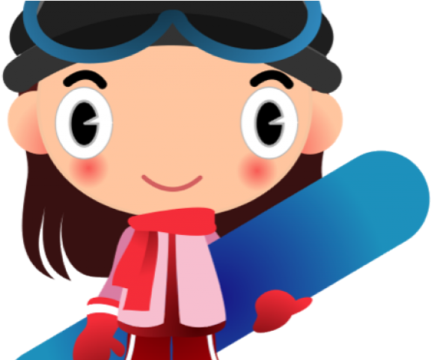
What lobe could be damaged?
Brittany fell while snowboarding and she wasn’t wearing her helmet.
Later that night when she was watching TV, she noticed that all the kids
on The Family Network
were really blurry!!
Occipital Lobe
Notes:
A: OCCIPITAL LOBE
The occipital lobe is responsible for vision.
Reinforce: It is AMAZING what our brains can do! It is so important to keep our brain safe!

Slide 17
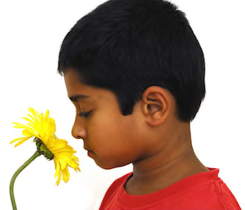
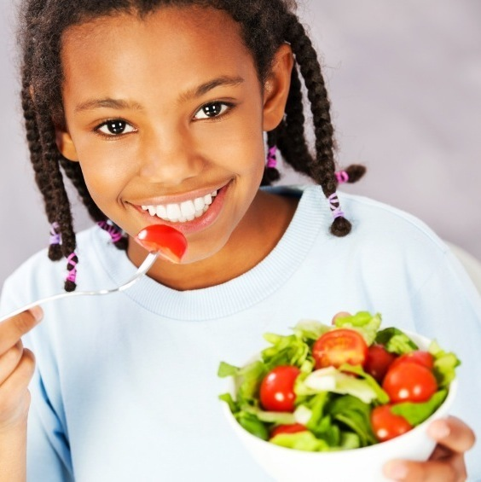
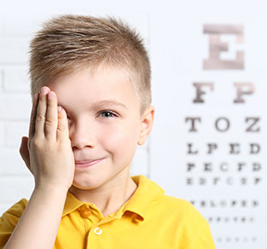

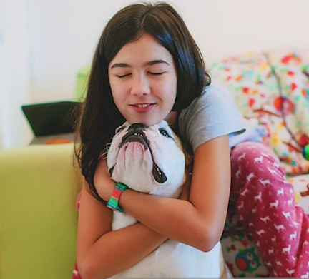
Five Senses
Smell
Taste
Vision
Hearing
Touch
Notes:
Q: Can someone tell me 2 of the 5 senses? (Take two answers at a time, to allow more students to participate in the discussion)
A: Vision, touch, smell, taste, hearing
We need our brain in order for our senses to work. If your brain is damaged your senses can be damaged. Today we are going to talk about how we are going to protect our brain, which protects our senses. For example, like we’ve just discussed, if we damage our occipital lobe which controls our vision, we still have our eyes, but they don’t work.

Slide 18
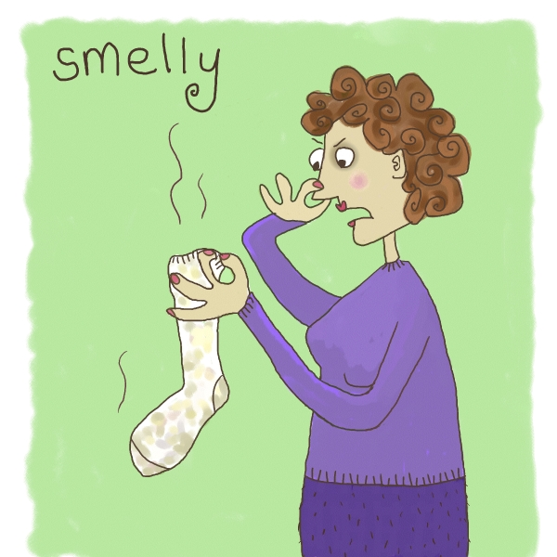
Smell
Notes:
Talk about the importance of smell:
Smell is important. Smell can help us know when there is danger (e.g., smelling a gas leak or when food has gone bad). We can also enjoy good smells, like cookies baking in the oven!

Slide 19
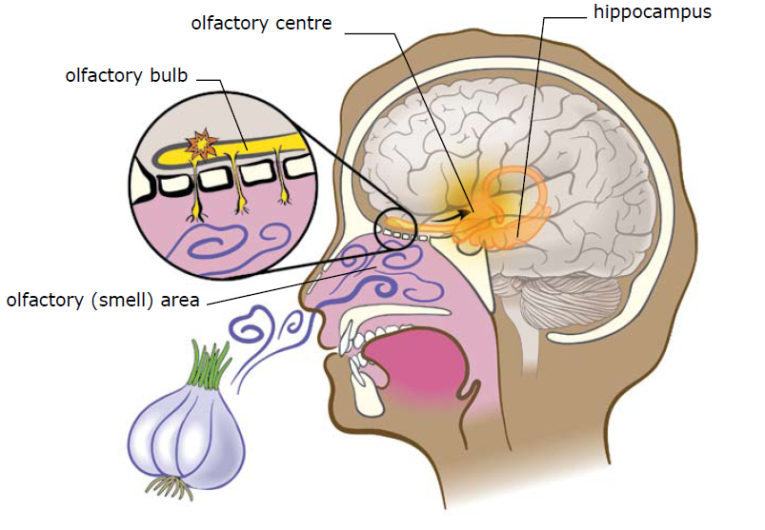
Q: How does the nose work?
olfactory centre
hippocampus
olfactory bulb
olfactory (smell) area
Notes:
Chemicals (odorants) are breathed in through our nose, and bind to special receptors. (Olfactory (smell) area)
With our sense of smell we sample our environment for information. We are continuously testing the quality of the air we breathe, for potential dangers such as smoke from fires, or food and flowers.
It is then sent to the olfactory bulb and into the temporal lobe of the brain. The brain translates the scent and we are able to tell what the scent is. For example: fresh baked cookies (ask the class for familiar smells)
Smell is also known as olfaction.
If asked, the hippocampus is where short term memories are converted to long-term memories.
PARIETAL LOBE controls sense of smell, and TEMPORAL LOBE helps you to remember what you are smelling.
19

Slide 20
Q: Which lobe controls smell?
Temporal Lobe
Notes:
Q → What lobe controls smell?
A → Temporal lobe

Slide 21

Smell
Q: Can you think of a smell that reminds you of something?
Notes:
Can you think of a smell that reminds you of something?
The systems involved in our sense of smell are linked to our memory.
21

Slide 22

Steps to the Brain
What do you call the substances you can smell?
_______________________
Where are the molecules received?
_______________________
Where in the brain are they perceived?
_______________________
Odorants
Olfactory (smell) area
Temporal lobe
Notes:
22
Have participants complete page 5 of the Activity Booklet.
“Steps to the Brain” Answer Key:
What do you call the substances you can smell? Odorants
Where are the molecules received? Olfactory epithelium (mucous membrane)
Where in the Brain are they perceived? Temporal Lobe

Slide 23
Activity Time!
Notes:
23
Activity: Olfactory Adaptation (Instructor Guide p. 8)
This activity has two parts. Complete part one, then move on to the next two slides. After completing the slides, complete part 2 of the activity.
Part 1
Spread the scent around the classroom.
What do you think of the smell? Rate the strength of the smell on a scale of 1 to 10 (Activity Booklet page 6)
Does the smell remind you of anything? Olfactory bulbs communicate with the parts of the brain that are responsible for our emotions and memory.
Can a smell change?

Slide 24
Anosmia
Q: What smell would you miss if you could not smell?
Q: Why is smell important?
Q: What situations would be dangerous if you could not smell?
Notes:
What if we couldn’t smell? Some people have a condition where they cannot smell anything. It is called Anosmia. Write this on the board. This means you cannot smell. These people miss out on many things. If they were burning their dinner, they would not be able to smell it.
A serious head injury may cause anosmia.
Q: What smell would you miss smelling if you could not smell?
Q: Have you ever lost your sense of smell?
A: You have probably experienced losing your sense of smell when you have been sick with a cold or flu.
Q: Why is smell important?
A: Helps a person detect dangerous situations such as smoke, etc. As well, it helps you to identify characteristics about your environment.
24

Slide 25
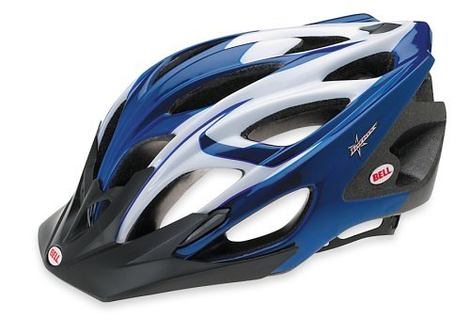
How do we protect our smell?
WEAR A HELMET!!
Notes:
Have the class shout out together “WEAR A HELMET!”
Q: How can we avoid losing our sense of smell?
A: By protecting our brain! E.g., Wear a helmet, wear a seatbelt, look both ways before crossing the street, etc.
Complete part two of the Activity:
Ask participants to rate the strength of the smell from part one again. Their rating should be lower this time. If it hasn’t changed, check back after the Taste lesson.
Have you ever adapted to a smell? E.g., Cooking at home
Why is adaptation important and useful? If we smelled everything all the time, we would be overloaded with stimulants.
Adaptation is experienced when a stimulus is present for a long time. After being in a freshly painted room for a while, the smell may not be as strong. However, someone entering the room for the first time will find the smell very strong because they are not adapted.

Slide 26
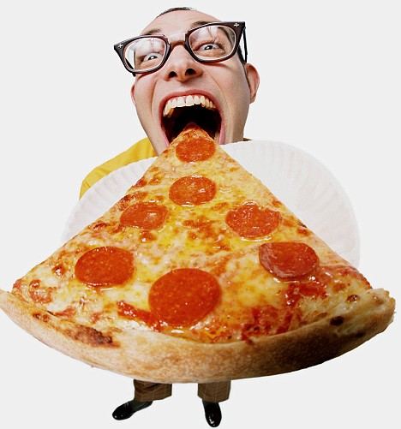
Taste

Slide 27
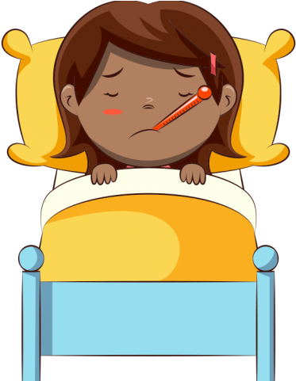
Question
Q: Has anyone noticed that if
you are sick with a cold your
food doesn’t taste as good?
Q: Does anyone know why that is?
    A: Smell and taste work together
Notes:
With a show of hands
Q: Has anyone noticed that if you are sick with a cold that your food doesn’t taste as good?
Q: Does anyone know why that is?
A: It’s because when you are sick, you get a stuffy nose, which means you can’t smell very well. Just like when you plug your nose when you eat something, you cannot taste it. This is because smell and taste work together to bring out the flavour of the food we eat.
Smell and taste are known as the chemical senses.

Slide 28
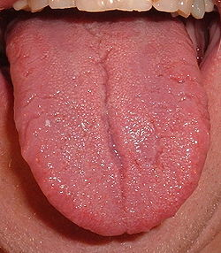
What do you see?
Stick out your tongue!
Notes:
Explain that this is the only time you can stick out your tongue at someone!
Have them pair up and ask what they see. (bumps/taste buds)

Slide 29
The Tongue
Notes:
Those bumpy things on your tongue are called taste buds or papillae (point to them on picture). A taste bud is a group of taste cells. Taste receptors are clustered into taste buds on our tongue, all over our mouth, on the roof of our mouth, epiglottis and upper esophagus.
Food that we eat is broken up into tiny pieces or molecules called tastants. These can only be seen with a microscope.
Taste buds have tiny hairs on them that can only be seen with a microscope. These tiny hairs send messages to the brain and tell us what type of food we are eating. For example, sweet or salty.

Slide 30
Q: Which lobe controls taste?
Parietal Lobe
Notes:
Q → What lobe controls taste?
A → Parietal lobe

Slide 31
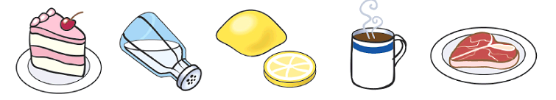
Steps to the Brain
What do you call the substances you taste?
_______________________
Where are the molecules received?
_______________________
Where in the brain are they perceived?
_______________________
Tastants
Taste Buds
Parietal Lobe
Notes:
Have participants complete page 12 of the Activity Booklet.
“Steps to the Brain” Answer Key:
A. What do you call the substances you taste? Tastants
B. Where are the molecules received? Taste Buds
C. Where in the brain are they perceived? Parietal Lobe

Slide 32



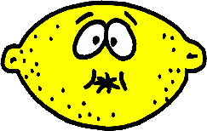
Q: What are the four types of taste?
Bitter
Sweet
Sour
Salty
Notes:
Q: What are the 4 types of taste? (Take one answer per participant to allow more people to participate)
A: Sour, sweet, bitter, salty
Can you provide me of an example of each type? SOUR…… SWEET…… BITTER…… SALTY…….

Slide 33
Activity Time!
Notes:
33
Activity: Taste Bud Mapping (Instructor Guide p. 11)
Use one or many flavours (salt water, sugar water, juice, vinegar, tonic water, and/or decaffeinated coffee). Distribute cotton swabs and taste cups.
Direct students to dip the cotton swab in the taste cups, then rub the swab on different areas of their tongue - the tip, the sides and the back. Remind students to take a new stick each time they dip!
Have students label the tongue map on page 12 of their Activity Booklets to determine the areas of the tongue that can “taste” the best.
Use the tongue map on the next slide to label the regions with more and fewer taste receptors.
Q: Why can you taste more on certain parts of your tongue?
A: Tastes are more intense where there are more taste receptors.
Q: Where can you “taste” the most?
A: The tip of the tongue has more receptors than the middle of the tongue. The sides and the back have more receptors than the middle, but fewer than the tip. Therefore, the tip should be the “tastiest” region, followed by the sides, back and finally, the middle of the tongue.

Slide 34
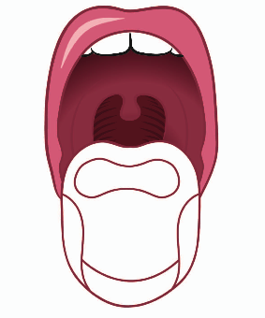
Taste Buds
There are more taste buds at the front of your tongue
There are fewer taste buds toward the back of your tongue
Notes:
Explain that there are more taste buds at the front of your tongue. There are fewer taste buds further back. Because of this, the front of your tongue is where the most taste occurs.
Ask: Have you ever burnt your tongue or had a sore tongue from eating too much sour candy? Explain that this is form damaged taste buds and it does not last forever. New taste buds are produced all the time.
Ask: How is this different from neurons? (Answer: neurons can’t be replaced or repaired. It’s important that taste receptors can be replaced, because they constantly come in contact with the outside world - hot liquids, food, fingers, etc.)

Slide 35
How do we protect our taste?
WEAR A HELMET!!
Notes:
Have the class shout out together “WEAR A HELMET!”
Q: How can we protect our taste?
A: By protecting our brain! E.g., Wear a helmet, wear a seatbelt, look both ways before crossing the street, etc.

Slide 36

Vision

Slide 37
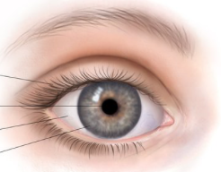
Anatomy of the Eye
Eyelid
Pupil
Sclera
Iris
Notes:
The human eye is ~2.5 cm in length and weighs about 7g (less than two nickels!). Muscles control the movement of the eye.
Parts of the eye:
The eyelid protects the surface of the eye.
Tears clean the eye’s surface.
The surface of the eye, the cornea, acts like a filter.
The iris and pupil adjust to the amount of light going into the eye.
The lens focuses the image you are looking at.
If asked, the sclera is the white outer layer of the eyeball. At the front of the eye it is continuous with the cornea.

Slide 38
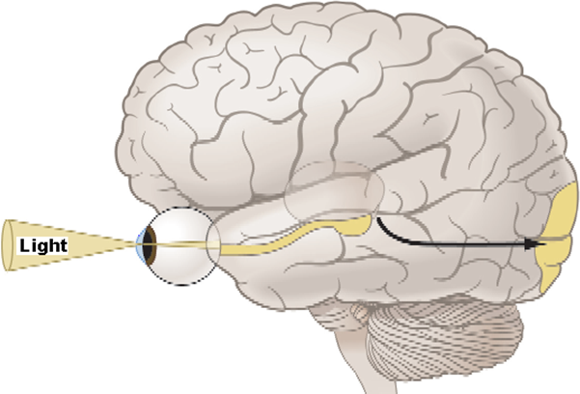
The Visual Pathway
Notes:
Pathway overview: Light enters through the lens (camera) →\ Retina → Optic nerve → Occipital Lobe (Visual cortex)
The process is explained further on the next slide.

Slide 39
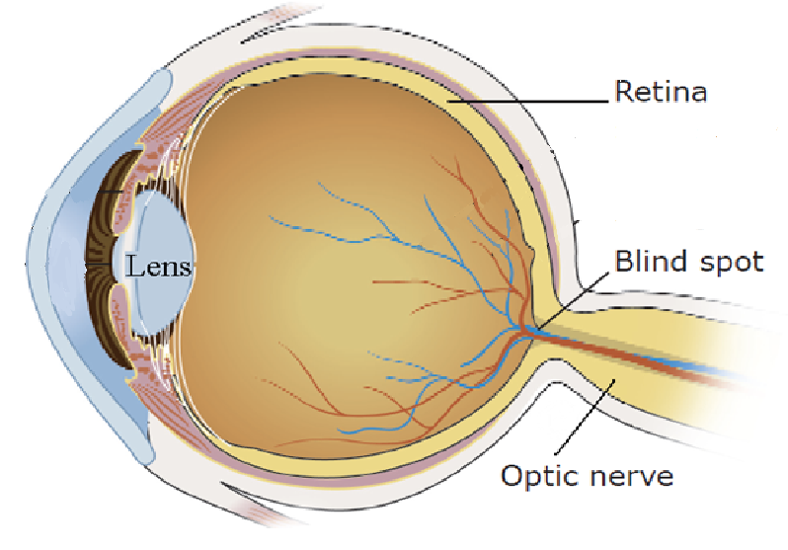
Vision
Retina
Blind spot
Optic nerve
Notes:
When light enters through the eye, it is captured onto the back of the eyes known as the RETINA.
The light then leaves the eye through the OPTIC NERVE and travels to the brain. The optic nerve exits the eye at the BLIND SPOT.

Slide 40
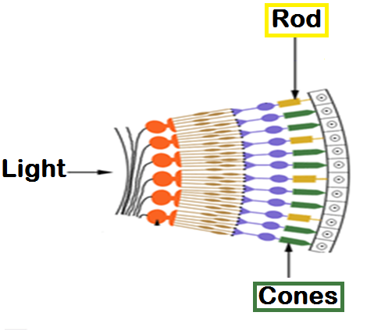
Rods & Cones
Rod
Cone
Notes:
Within the retina, there are two different types of cells that sense light:
Rods → Help us see in the dark and see movement
Cones → Helps us see colors and detail

Slide 41
Q: Which lobe controls vision?
Occipital Lobe
Notes:
Q → What lobe controls vision?
A → Occipital lobe

Slide 42
Steps to the Brain
I G H T
A. We see: L __ __ __ __
B. Where the light rays are received: R __ __ __ __ __
  On the retina, there are 2 types of cells (photoreceptors).
  i. R __ __ __ are for dark vision and detection of movement
  ii. C __ __ __ __ are for colour vision and detection of fine detail.
Information from our retina exits the eye at the B __ __ __ __ S __ __ __
C. Where in the brain it is perceived:
O __ __ __ __ __ __ __ __ L __ __ __
E T I N A
O D S
O N E S
L I N D
P O T
C C I P I T A L O B E
Notes:
Okay, now that we have reviewed that, we are going to complete these questions together!
Have participants complete page 14 of the Activity Booklet.
“Steps to the Brain” Answer Key:
A. We see: Light
B. Where the light rays are received: Retina
On the retina, there are 2 types of cells (photoreceptors).
i. Rods are for dark vision and detection of movement
ii. Cones are for colour vision and detection of fine detail.
Information from our retina exits the eye at the Blind Spot.
C. Where in the brain it is perceived: Occipital Lobe

Slide 43
Activity Time!
Notes:
43
Activity: Blind Spot (instructor Guide p. 12)
Draw an X at one end of a strip of paper and an O at the other end.
Hold the strip of paper with your left hand at arm’s length, with the letters facing you. The X should be on the right and the O should be on the left.
Cover your right eye with your right hand and focus your left eye on the X.
While focusing on the X, move the strip toward you until the O disappears.
When the O disappears, you have found your blind spot.

Slide 44


Colour Afterimage
Notes:
Activity: Colour Afterimage (Instructor Guide p. 12)
Instruct participants to look at the image for 1 minute.
Advance to the next slide.

Slide 45
Notes:
[Slide intentionally left blank]
Ask: What do you see?

Slide 46
Colour Afterimage
Notes:
Let’s try another one.
Instruct participants to look at the image for 1 minute.
Advance to the next slide.

Slide 47
Notes:
[Slide intentionally left blank]
Ask: What do you see?

Slide 48
Colour Afterimage
Notes:
One more.
Instruct participants to look at the image for 1 minute.
Advance to the next slide.

Slide 49
Notes:
[Slide intentionally left blank]
Ask: What do you see?
This activity demonstrates the Opponent Processing Theory of Colour Vision. Every colour has an opposite colour. Afterimages are seen because neurons become adapted to the colour you are staring at. If you look at the image too long, the neuron gets tired and removes the block on the opposite colour when the image is removed.
Ask:
Q: Do you know what achromatopsia is?
A: It is colour blindness. Some people are not able to see colour because they are missing a cone type, have an abnormality in the cone, or have some abnormality in the colour perception area of the occipital lobe. There are tests to check for colour blindness. How would colour blindness affect you?

Slide 50
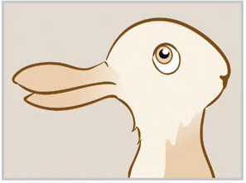
Reversible Figure Illusions
Notes:
Activity: Reversible Figure Illusions
I am going to put up a picture on the screen, I want you to tell me what you see.
Q: What do you see in this picture? A rabbit or a duck?
A: Those who see a duck, raise your hand. Those who see a rabbit, raise your hand.
Show where both are on the image so all participants can see both.

Slide 51

Reversible Figure Illusions
Notes:
Tell me what you see.
Q: When you look at the black part of the picture, what do you see?
A: 2 faces, looking at each other.
Q: Now, focus on the white part. What do you see?
A: A vase or a cup
Show where both are on the image so all participants can see both.

Slide 52
Reversible Figure Illusions
Notes:
Tell me what you see.
Q: What do you seen in this picture? A young girl or an old woman?
A: Those who see a young girl, raise your hand. Those who see an old woman, raise your hand.
Point out both figures on the image for the participants.

Slide 53
How do we protect our vision?
WEAR A HELMET!!
Notes:
Have the class shout “Wear a Helmet!!”
Q: How can we protect our vision?
A: By protecting our brain! E.g., Wear a helmet, wear a seatbelt, look both ways before crossing the street, etc.
It’s also very important to protect our eyes. Don’t run with sharp things in your hands (like scissors), wear proper eye protection during sports and science experiments, get your eyes regularly examined, etc.

Slide 54
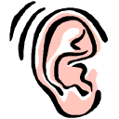
Hearing
Notes:
54

Slide 55
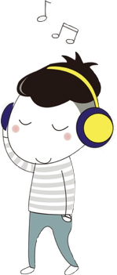
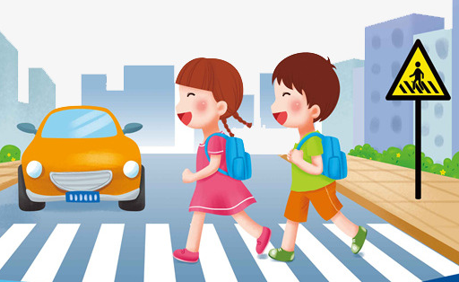


Q: Why do you need your hearing?
Communication
Listen for danger
Be aware of your surroundings
Enjoyment
(e.g., music)
Notes:
Ask: Why do you need your hearing? Get a few responses then show them the answers on the screen. Explain each one:
Communication: Hearing allows us to communicate with others
Listen for danger: We learn different noises that mean danger – i.e., fire alarm tells you to get out of the building.
Be aware of surroundings: We associate different sounds for different areas – i.e., outside you can hear birds chirping, on a busy street hear the cars go by.
Enjoyment: People enjoy listening to music or outdoor sounds such as birds or waves at the beach.

Slide 56
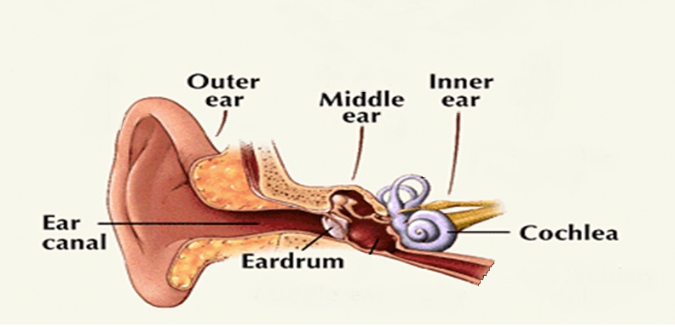
Three parts of the ear
Notes:
3 parts of the ear
Outer Ear - Collects sound waves and sends them to the eardrum.
Middle Ear - Air-filled space containing ossicles, the 3 smallest bones in the human body. Ossicles amplify and transmit sound vibrations to the inner ear.
Inner Ear- consists of the cochlea (snail shaped structure). Has hair cells that receive the vibrations and send signal to auditory nerve, and then onto the temporal lobe where the brain interprets the signal.

Slide 57
Q: Which lobe controls your hearing?
Temporal Lobe
Notes:
Q → What lobe controls your hearing?
A → Temporal lobe

Slide 58
Steps to the Brain
We hear:
S __ __ __ __ W __ __ __ __
Where the sound energy is received:
C __ __ __ __ __ __
Hair cells in the cochlea pick up sounds and transmit auditory information to the brain.
Where in the brain it is perceived:
T __ __ __ __ __ __ __ L __ __ __
O U N D A V E S
O C H L E A
E M P O R A L O B E
Notes:
Have participants complete page 16 of the Activity Booklet.
“Steps to the Brain” Answer Key:
We hear: Sound Waves
Where the sound energy is received: Cochlea
Hair cells in the cochlea pick up sounds and transmit auditory information to the brain.
Where in the brain it is perceived: Temporal Lobe

Slide 59

Activity time!
Traffic
Car Horn
Train
Notes:
Note: To play sounds, click directly on the speaker icons. If you click elsewhere on the slide, the answers will appear.
Ask the class to cover their ears. Play the first sound. Ask them to guess what the sound was.
Now replay the sound with their ears uncovered and enforce how important it is to have your hearing while riding your bike, rollerblading etc.
Try to avoid wearing your headphones, etc.
How do you know if headphones are too loud? There’s a simple test. Put them in your hand, close your fist...if you can still hear the sound, they are too loud
Repeat for sounds 2 and 3.
Option: Sound Localization Activity (Instructor Guide p. 14)

Slide 60
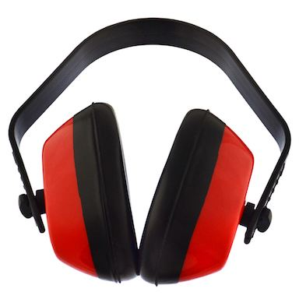
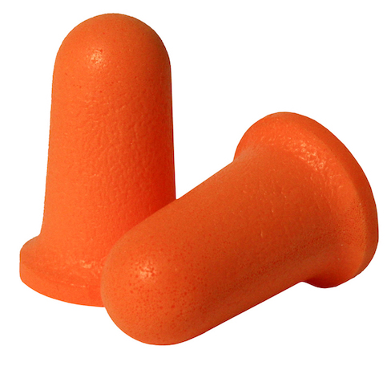
Q: How can you protect your hearing?
Notes:
60
Ask the class how you can protect your hearing.
Examples: Wear ear plugs, turn down your music, make sure if you feel like you have an earache get it checked out by a doctor, don’t stick objects in your ears.

Slide 61
How do we protect our hearing?
WEAR A HELMET!!
Notes:
We also protect our hearing by protecting our brain! E.g., Wear a helmet, wear a seatbelt, look both ways before crossing the street, etc.

Slide 62
Sense of touch
Notes:
62

Slide 63

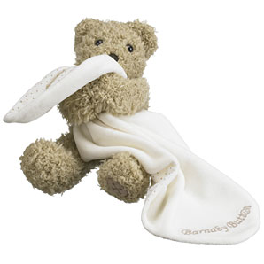
Q: Why is touch important?
Comfort
Detect Danger
Personal Contact
Notes:
Q: Why is touch so important?
A: Touch is important because it allows you to feel comfort (e.g., a soft blanket), it can help you sense if something is dangerous (such as a hot doorknob), and lets you communicate with others (e.g., give someone a hug).
63

Slide 64
Q: What are four types of touch?
Pain
Temperature
Pressure
Vibration
Notes:
Ask the class if they know of five ways we may be able to feel through touch and give examples.
Pain (if something hurts) ex. Paper cut
Temperature (hot or cold) ex. Touching a hot stove
Pressure (soft or hard) ex. Getting a bear hug
Vibration (like an earthquake or riding in a car)
A fifth type of touch:
Proprioception (in the dark or if we can not see we still know where are hands or legs are in relation to our body)

Slide 65
Q: Which lobe controls touch?
Parietal Lobe
Notes:
Q → What lobe controls your hearing?
A → Parietal lobe

Slide 66
Steps to the Brain
Where are your touch receptors?
S __ __ __
B. Where in the brain is the signal perceived?
P __ __ __ __ __ __ __
L __ __ __
K I N
A R I E T A L
O B E
Notes:
Have participants complete page 17 of the Activity Booklet.
“Steps to the Brain” Answer Key
Where are your touch receptors? Skin
Where in the brain is the signal perceived? Parietal Lobe
(continued on next slide)

Slide 67
Steps to the Brain
C. These receptors allow us to feel:
  P __ __ __
  P __ __ S __ U R __
  V __ __ __ __ T I O N
  T __ __ P__ __ __ __ __ __ __
A I N
R E S E
I B R A
E M E R A T U R E
Notes:
Have participants complete page 17 of the Student Activity Booklet.
“Steps to the Brain” Answer Key
(continued from previous slide)
C. These receptors allow us to feel:
Pain
Pressure
Vibration
Temperature

Slide 68
Activity Time!
Notes:
68
Activity: Two-Point Discrimination Demonstration (Instructor Guide p. 16)
Have a volunteer close their eyes and hold out their hand.
Gently touch their finger using two cottons. Remember how far apart the cotton swabs are.
Ask: How many cotton swabs am I using to touch you? (They should say two)
Gently touch their arm using the two cotton swabs. Make sure the swabs are the same distance apart as before.
Ask: How many swabs did I use to touch you this time? (They should say one)
Result: It will be easier for the student to distinguish the swabs at the fingertips than their arm (more receptors in fingers).
There are more touch receptors at the fingertips than the arms. This is called receptor distribution.

Slide 69

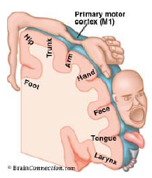
Homunculus
Q: What body part has the most
sensory receptors?
A: Hands, tongue and lips
The bigger the body part on Homunculus, the more you will feel on that body part.
Notes:
Q: What body part has the most sensory receptors?
A: Hands, tongue and lips
The size of sensory receiving areas, relative to different body parts, is shown by the unusual proportions of the homunculus. A larger area in the brain means a greater sensitivity of that body part, relative to other body parts. Very sensitive areas of the skin, like fingers, have very high densities of receptors and closely packed neurons.
Looking at the homunculus, notice that the hands and fingertips are larger than the knees and forearm. The amount of brain devoted to each body part is important to determine how sensitive that body part is to touch. The more brain devoted to the function of a body part, the more sensitive it is. Use the homunculus slide to show that the fingers, mouth, tongue have a greater representation in the homunculus.

Slide 70
How do we protect our touch?
WEAR A HELMET!!
Notes:
Have the class shout “Wear a Helmet!!”
Q: How can we protect our touch?
A: Wear a helmet, wear a seatbelt, look both ways before crossing the street, etc.

Slide 71
Concussions
Q: What is a concussion?
A: A type of brain injury!
Any blow to head, face, neck or body, which causes sudden jarring of the brain inside the skull may cause a concussion.
Notes:
Ask: If you have ever had a concussion raise your hand. Now, if you have ever had a brain injury raise your hand.
A concussion is a type of brain injury, but most people do not realize this. The number of students raising their hands for concussion may be different from those doing so for brain injury. Emphasize that a concussion is a type of brain injury.
A concussion is a brain injury that any person may experience at some point in their life. A concussion can affect the way a person thinks, feels and acts.
Any blow to the head, face, neck or body, which causes the brain to move around inside the skull, may cause a concussion.

Slide 72

Concussions 101 - Dr. Mike Evans
Notes:
[To play the video clip, move the mouse onto any part of the rectangle on the screen. A control bar will appear under the box. Click play]
If possible, show the video clip (~ 6 minutes):
This video clip encompasses all of the aspects about concussions we wish to teach the students. We will use the points in the video and highlight them in subsequent activities.

Slide 73
Concussion Symptoms
Physical | Cognitive (Thinking) | Emotional | Sleep-Related
Headache Loss of consciousness Nausea or vomiting Sensitivity to light or noise Dizziness Tired “Pressure in the head” | Feeling like “in a fog” Being confused Difficulty remembering Difficulty concentrating | “I don’t feel like myself” Moody or grumpy Sadness Nervous or anxious | Sleep less than usual Sleep more than usual Trouble falling asleep
Notes:
Q: How does a concussion affect your mind, body, and feelings?
A: A concussion affects the way the brain functions. Because the brain does so many different things, a concussion may affect a person in lots of different ways.
Concussions cause various signs and symptoms. A person with a concussion might experience one or more of these. Each concussion is unique.
Option: Scrambled Brains Activity (Instructor Guide p. 18)

Slide 74
What if you think you have a concussion?
S-T-A-R
Stop Playing!
Tell an adult, Get Assessed, and
Rest!
Notes:
Q: What do you think you should do if you think you have a concussion?
A: S-T-A-R: Stop Playing, Tell an Adult, Get Assessed, and Rest!
Explain what each of these means:
STOP Playing! - Need to stop playing immediately (game, practice, recess, Phys Ed class, etc.)
TELL an adult - Tell a coach, teacher, parent, or another adult you trust right away
Get ASSESSED - Get checked by a doctor
REST! - If you have a concussion, rest is the first step for getting better!
Resting your brain means you need to get proper sleep and might have to stop (or limit) doing things for a bit if they make your symptoms worse, such as playing video games. You might need to stay home from school.
Q: What do you think you can do to help your friend or classmate if they have a concussion?
A: Encourage them to tell an adult if they think they have a concussion; Share the concussion information you have learned with them; Reassure and support them while they are recovering and returning to school – let them know they are not alone!

Slide 75
Summary
Q: Why is it important to protect your brain?
  Smell
  Taste
  Vision
  Hearing
  Touch
Notes:
Based on all you’ve learned today, why is it important to protect your brain?
Smell
Taste
Vision
Hearing
Touch
All our senses are interrelated, and our brain is like a computer it helps us find the meaning of all our senses. For example, is there a sound that you really like and what does it make? Your senses mean something to you.
How can you protect your brain?
Wear a helmet, wear a seatbelt, look both ways before crossing the street, etc.

Slide 76
How do we protect our brain?
WEAR A HELMET!!
Notes:
Have the class shout out together “WEAR A HELMET”

Slide 77
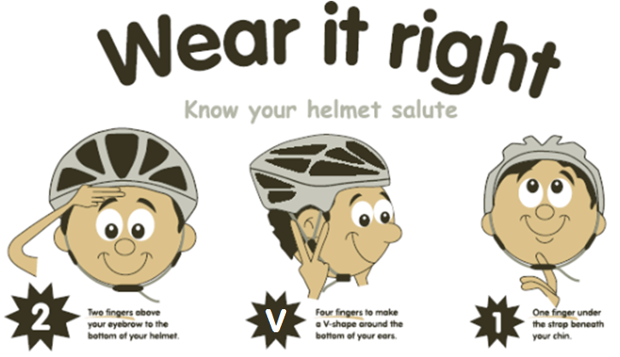
2-V-1 Rule
Notes:
Ask for a volunteer to be a helmet model
Q: Who knows the 2-V-1 rule for bicycle helmets?
Rule:
2 fingers above the eyebrows is where the helmet should start
V – 2 fingers in a V under each earlobe representing the V strap that should fit snug under the ear
1 finger represents the amount of room between the chin strap and the chin.
Demonstrate each rule on the student as you go along
Have the rest of the students mimic the actions you just did so that everyone is involved. Then pick two volunteers and have one volunteer fit the other appropriately with the helmet and ask the whole class if it has been done right demonstrating the 2-V-1 rule again.
**Have the participants shout 2 – v – 1 while doing the actions with you at least 3 times in a row.

Slide 78
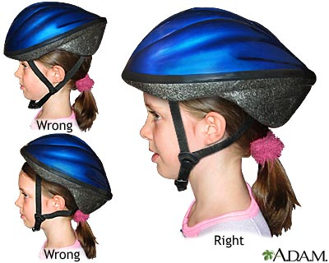
Questions
Q: Should you wear a helmet over a baseball hat or high ponytail?
Notes:
Q: Should you wear a helmet over a baseball hat or high ponytail?
A: NO. It does not allow the helmet to sit properly on your head, and so it won’t protect you the way it is supposed to.
**DON”T SAY ANYTHING ABOUT STICKERS IF NOT ASKED
Q: Should you ever put stickers on your helmet?
A: NO:
ｷ Helmets should not be painted or decorated with stickers
ｷ Helmets are supposed to be shiny and smooth (show helmet) to absorb the shock if you fall off your bike
Stickers make the helmet rough and it can’t absorb as much of the shock, as well stickers can cover an area where a crack may have occurred.

Slide 79
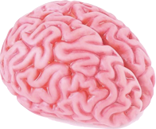
Touch a Brain!
Your brain is fragile. Why do you think it’s important to protect it?
Notes:
Pass around the brain mould now.
Presenter starts showing the mold on one side of classroom

Slide 80
Thank You!
Notes:
Thank the participants. Thank the teacher or supervisor.
If you have giveaway materials, such as 2v1 bookmarks or concussion handouts, give them to the teacher or supervisor.

